Slide 1

Course Registration System
JEDI Group 2

Slide 2
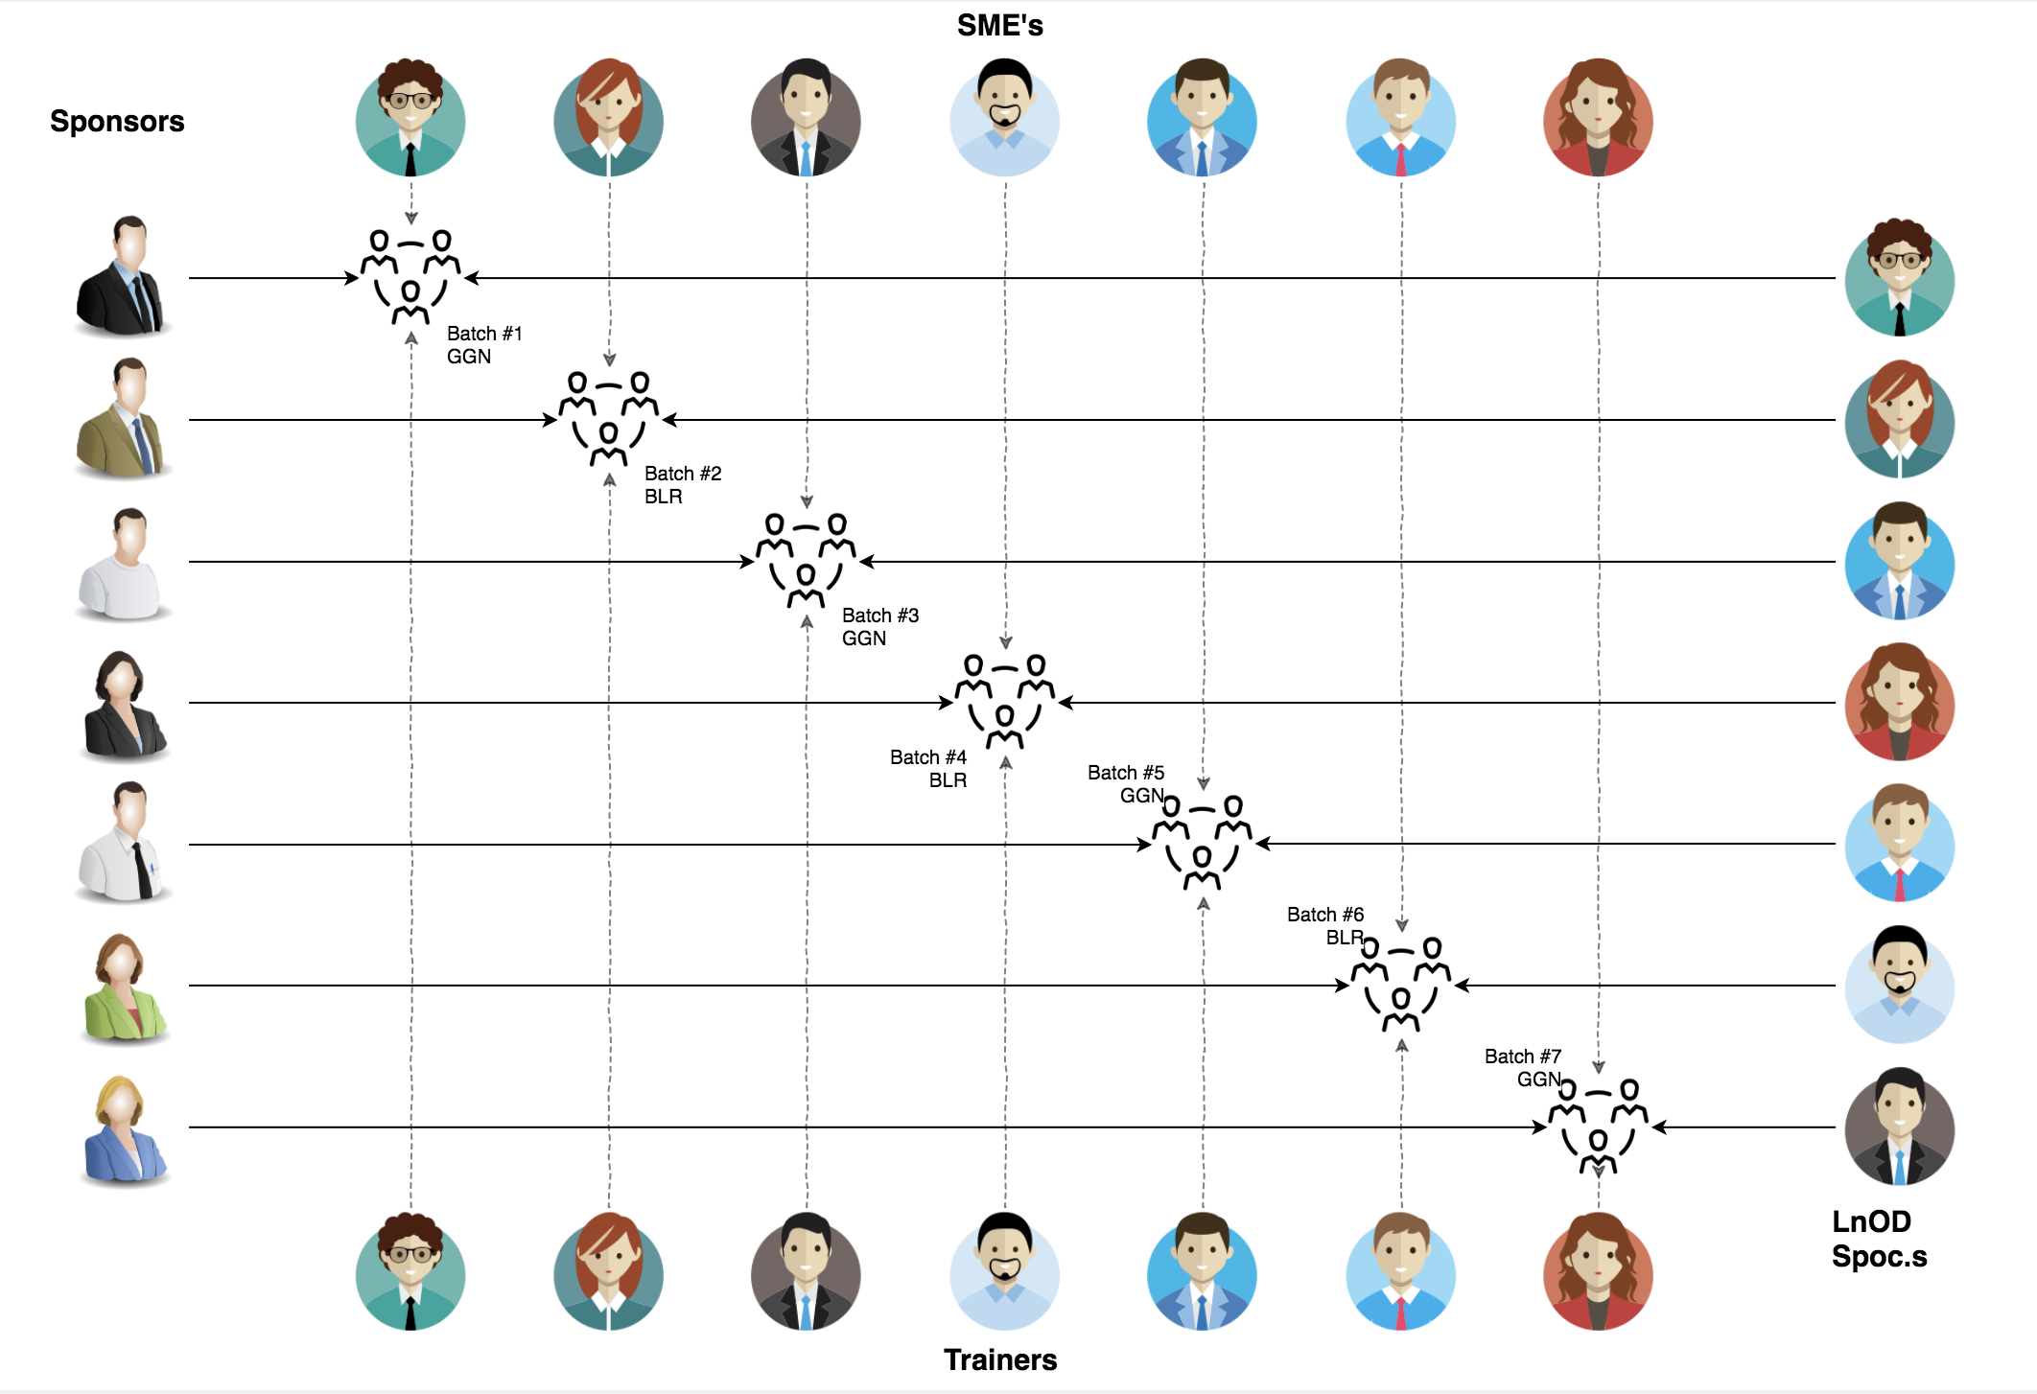
Stakeholders
Sponsors
Flipkart
SME’s
Amit Balyan
Other HR & Experts
Course Coordinators
Shree
Heena Bansal
Surbhi Sukhant

Slide 3
2 WEEKS OF TRAINING + PROJECT DEMO
14 DAYS
112 HOURS
6720 MINUTES
403,200 SECONDS
LIMITLESS KNOWLEDGE

Slide 4

Agenda
01
Our Journey
02
Our Team
03
Team Structure
04
Problem Statement
05
Engineering Practices
06
Tech Stack
07
Development
08
Challenges & Learnings
09
Demo
10
Questions
Notes:
Time – 1 min

Slide 5

Our Journey
Notes:
Time - 2 mins

Slide 6
Demo
Mindset
Process
5
Project Demo
Tools
4
Adapting to a developer
Mindset
Comprehend
3
Design Thinking
2
Decide the Technologies JAVA/REST
1
Understanding Project Goals

Slide 7
LEARNING ACTION PLAN
 | Modules | Description
July 20 - July 25 | UNIX GIT UML Diagrams | Understanding Unix and Git commands Requirement understanding and diagram design
July 26 - August 2 | Java 8 Exception Handling SQL | Developing a POS Application using Java and MySQL. Understanding Java 8 features and collections
August 3 | Jersey and DropWizard | REST API Development using Jersey and DropWizard framework

Slide 8

Our Team
Notes:
Time – 2 mins

Slide 9

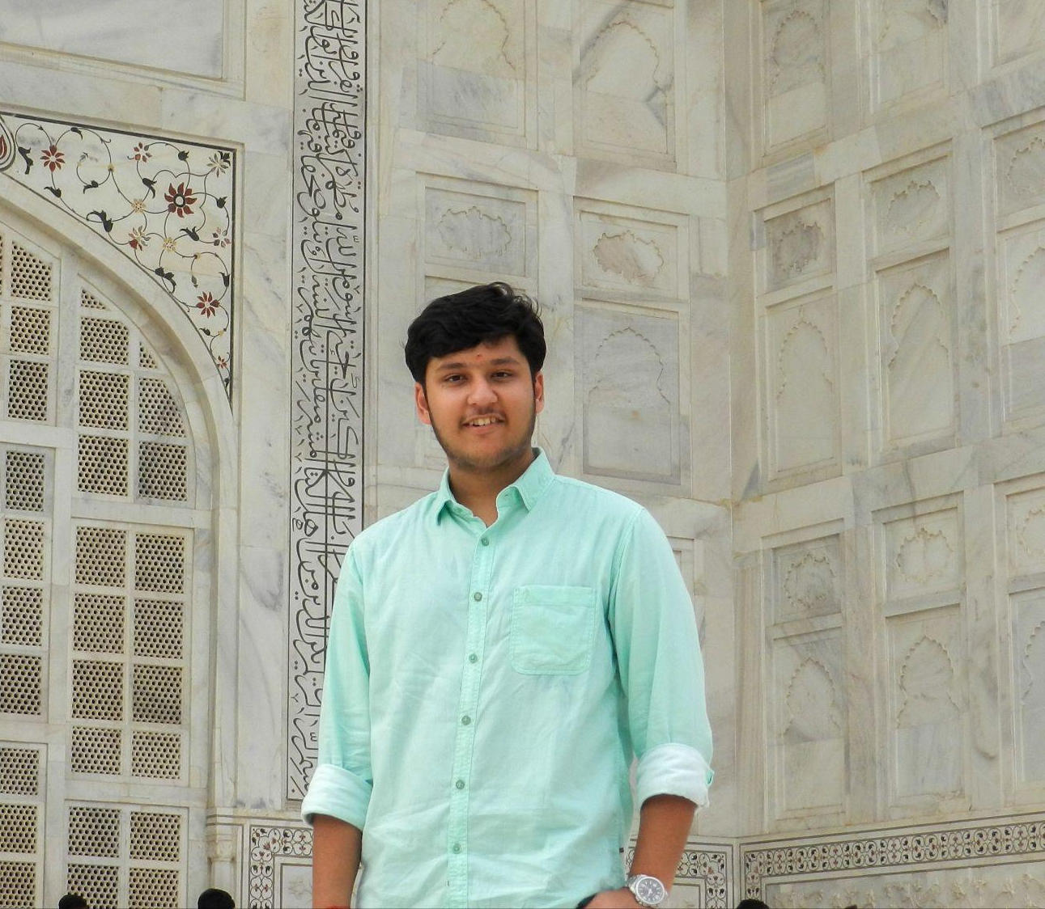
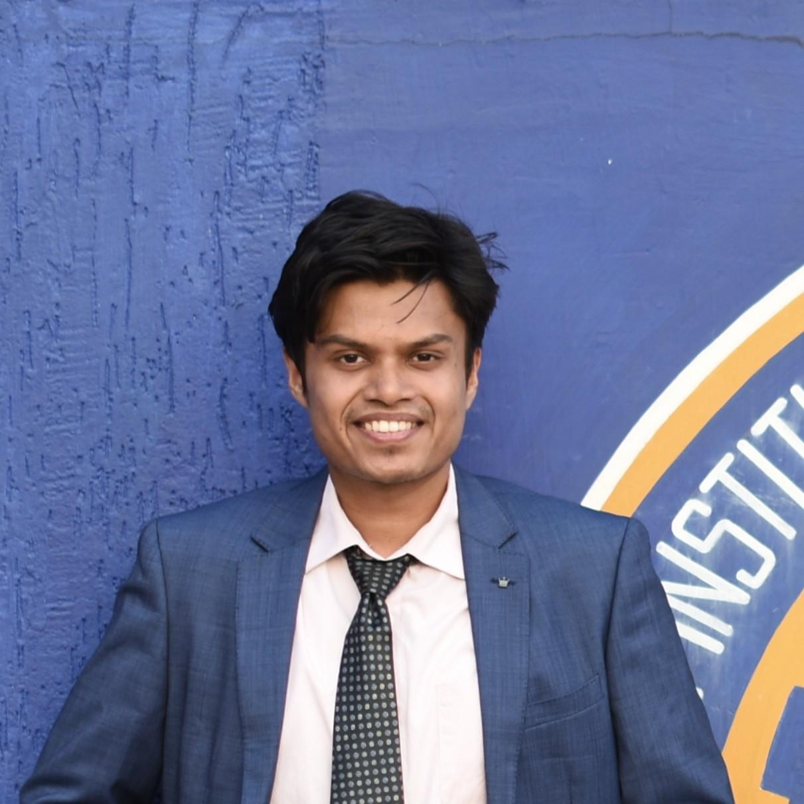

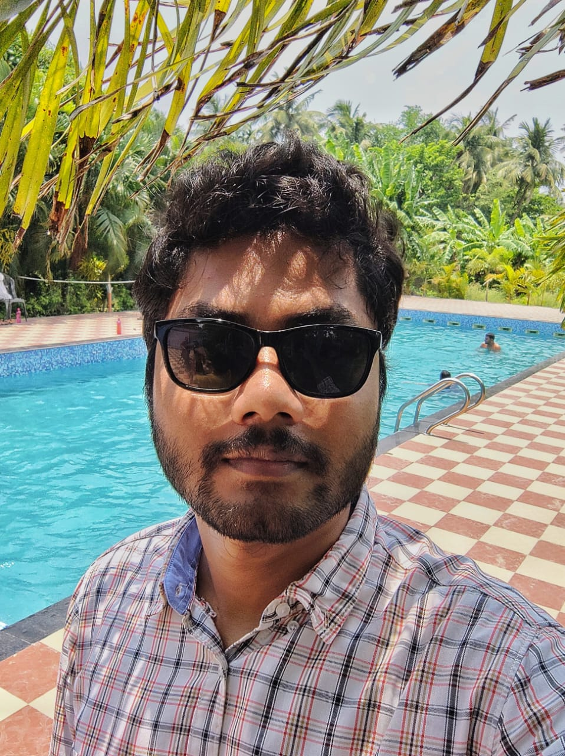
Anmol Srivastava
Kushal Agarwal
Kazi Abeer Rehaman
Lakshay Dua
Sabuj Jana

Slide 10

Project Goals
Notes:
Time – 3 mins

Slide 11




Problem Statement
To develop a POS application and REST API for Course Registration System using JAVA where the student can register, add/drop course, professors can view courses, enrolled students while admin can manage users, add/drop courses to catalog.
1
2
Quality
Security
3
4
Interactivity
Speed
Notes:
User satisfaction and brand value
Problem Statement

Slide 12

Engineering Practices
Notes:
Time – 5 mins

Slide 13
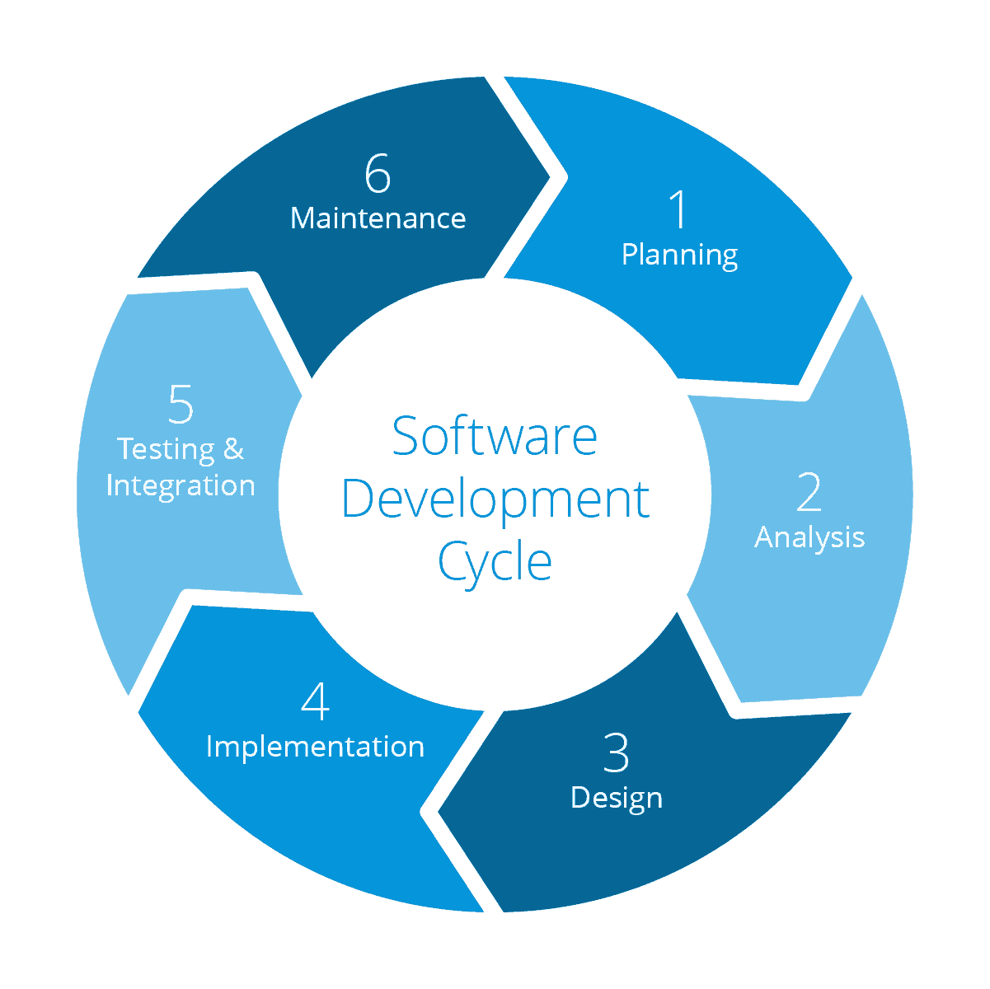
Requirement Gathering
Future
Maintenance
Tech Stack Selection
Testing
UML Artifacts, Architecture Design
Code development
Notes:
Implementation ->

Slide 14
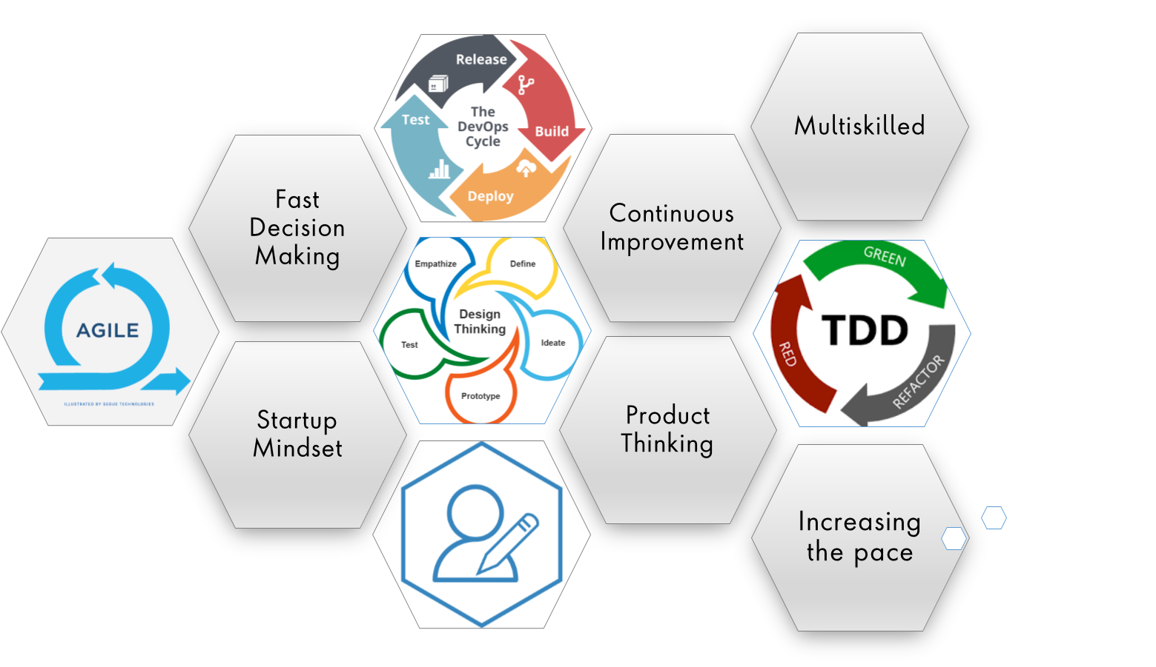
Notes:
Product Thinking (Design Thinking, Requirement Analysis, )
Multi Skilled (Frontend, Backend, DevOps)
Fast Decision Making (Agile)
Increasing the Pace (Automation CI/CD)
Startup Mindset (Agile)
Continuous Improvement (Retros)

Slide 15

Tech Stack
Notes:
Time – 2 mins

Slide 16













Designing
Backend
Testing
Data
SCM
UML
Core Language
Tools
SQL Database
Code Collaboration
Framework
Application Server
Notes:
Time – 1 min
Java
Maven
DropWizard
MySQL
Jersey
GitHub
Postman / ARC (Check it)
StarUML / Dia / Lucid Charts
List
Design
Backend
Testing
Tools

Slide 17

Challenges & Learnings
Notes:
Time – 2 mins

Slide 18
 | Challenges | Learning
July 20 - July 25 | Understanding the problem statement Collaboration issues such as merge conflicts in Git UML diagram conventions | LINUX Git commands UML Diagrams
July 26 - August 2 | Installation softwares on multiple environments POS application development using layered architecture | Java 8 Exception Handling SQL
August 3 | Resolving jar and version dependencies Jersey validation | REST API development using Jersey and DropWizard Maven DropWizard

Slide 19
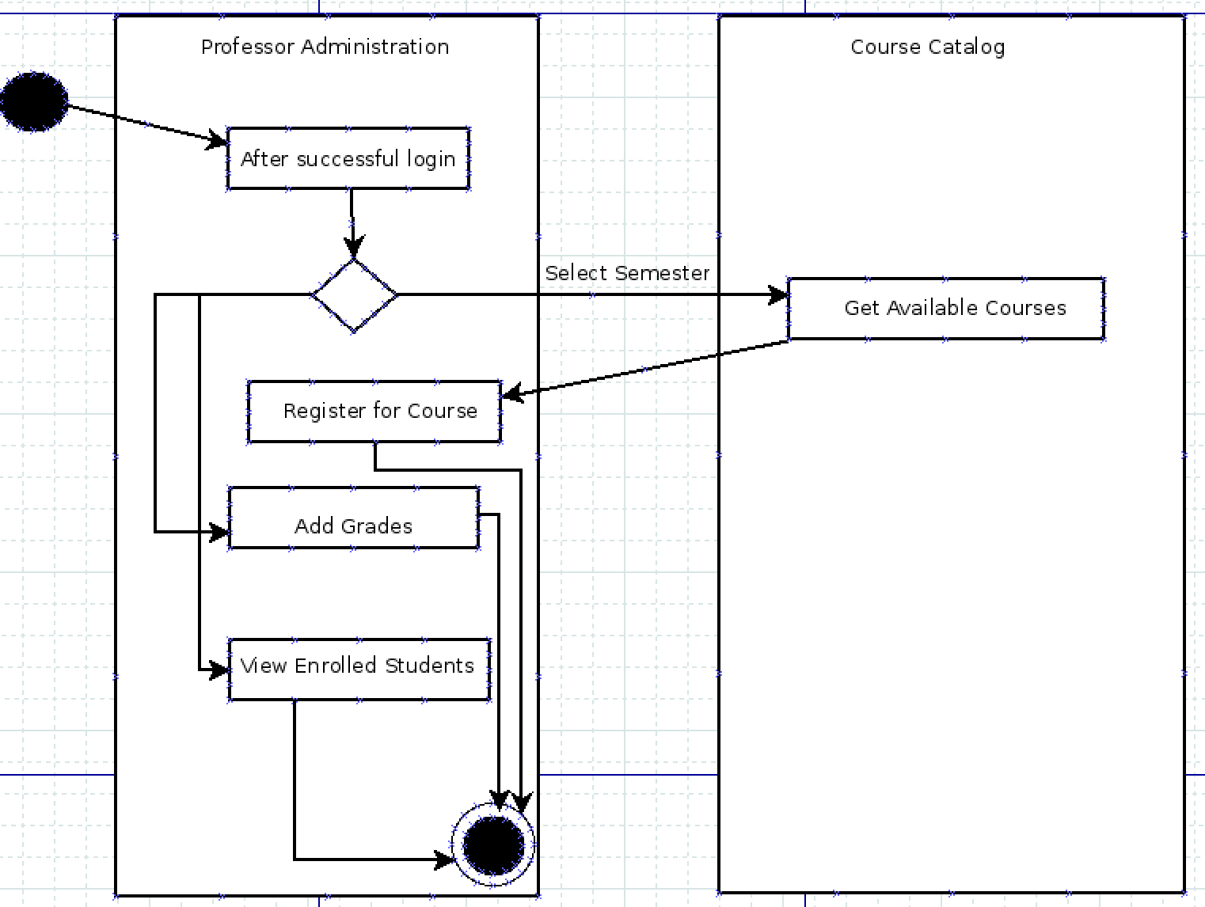
UML Diagrams

Slide 20
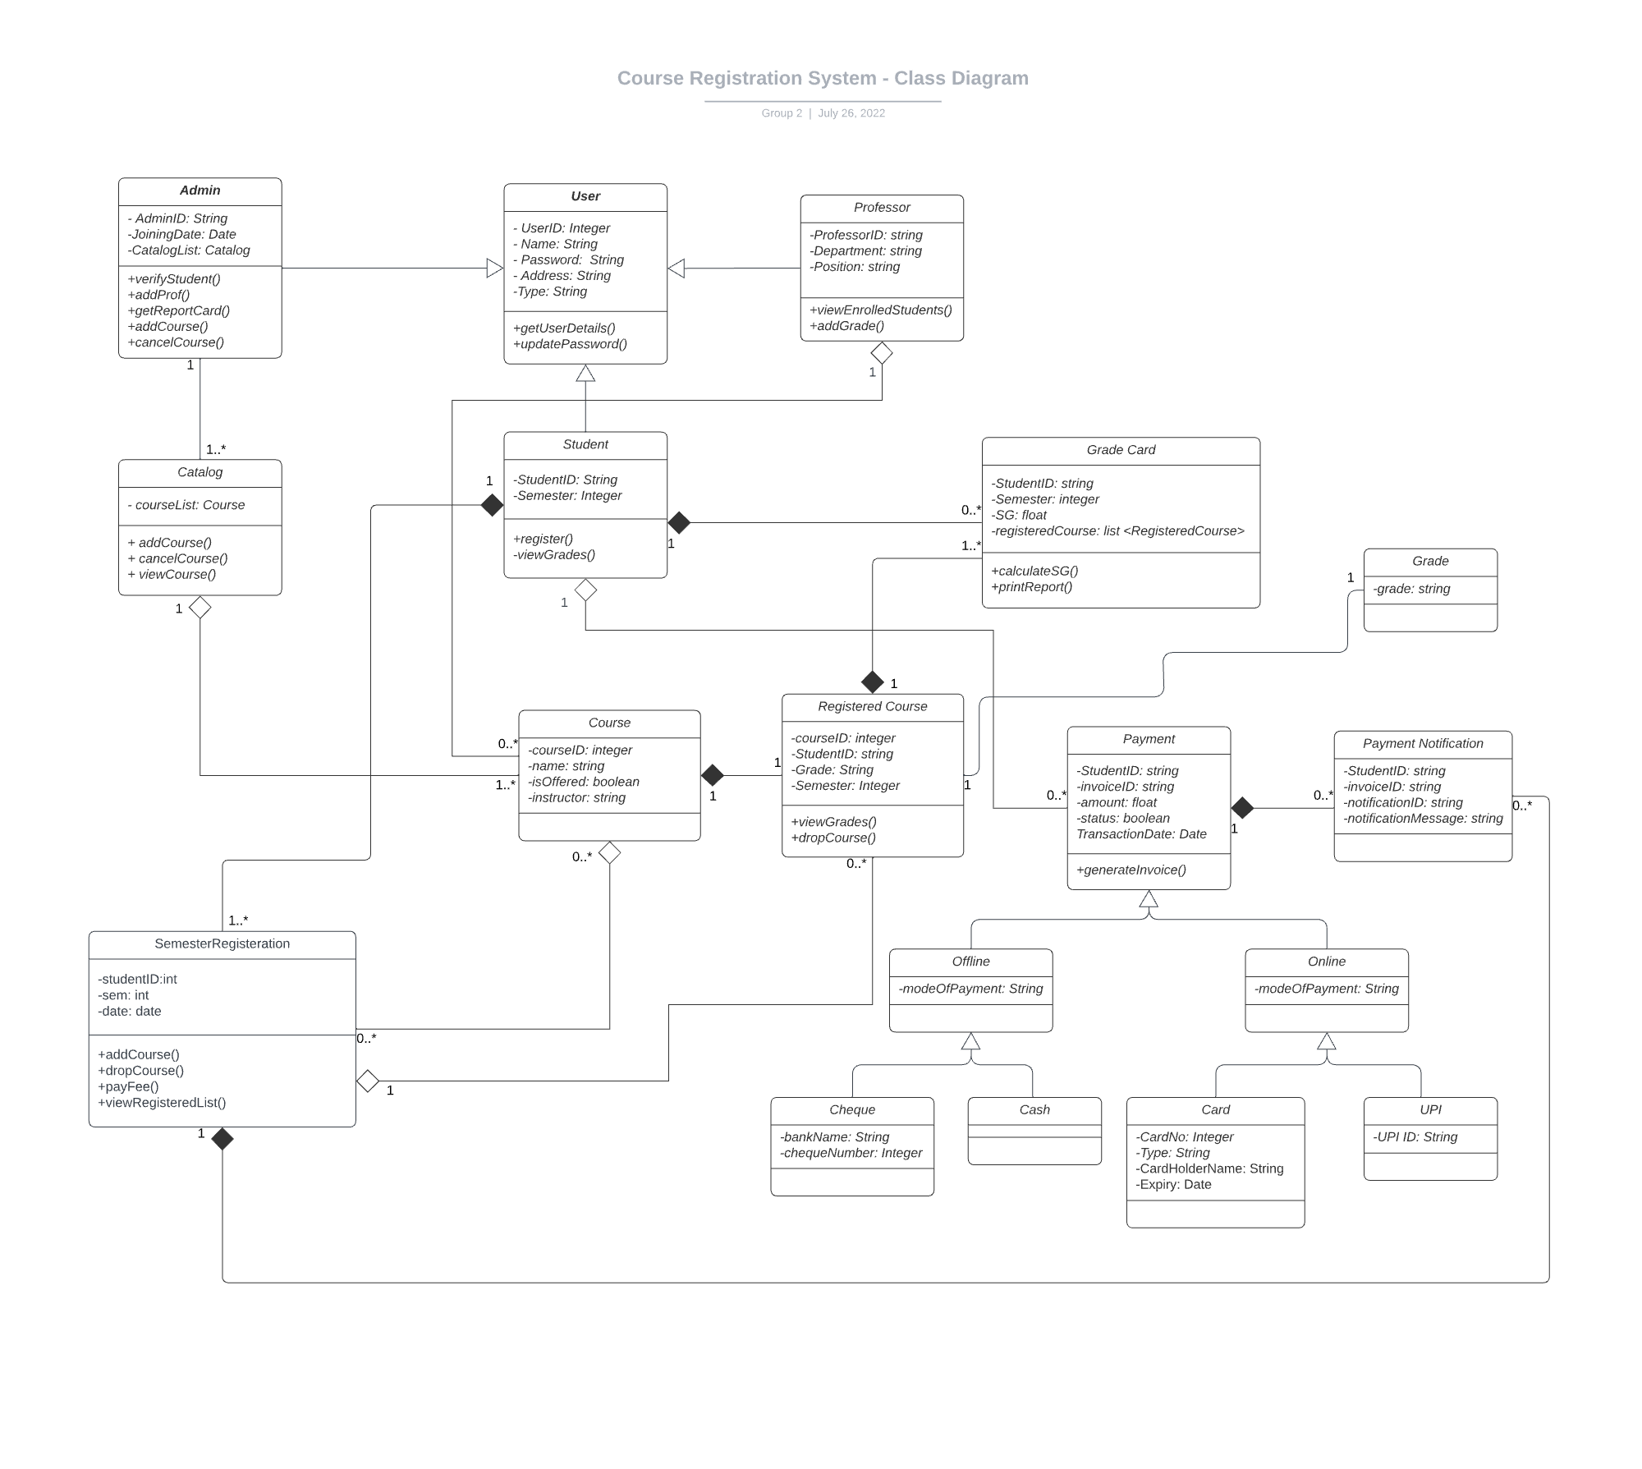

Slide 21

Architecture Design
Notes:
Time – 1 min

Slide 22

POS Application
Java Main Client
Services
Data Access Objects
HTTP Request
HTTP Response
Notes:
n-tier

Slide 23

Demo
Notes:
Time –
Architecture – 5 mins
NFR Dashboard – 3 mins
Demo – 10 mins
1. Show the Responsiveness and Wave tool first

Slide 24

Questions
Notes:
Time - ?

Slide 25
Thank you

